Slide 1
Materials Science and Engineering
Dr. Ranjit Kumar
Department of Chemical Engineering
Email: ranjit.kumar@snu.edu.in

Slide 2
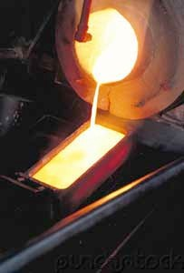
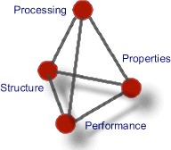
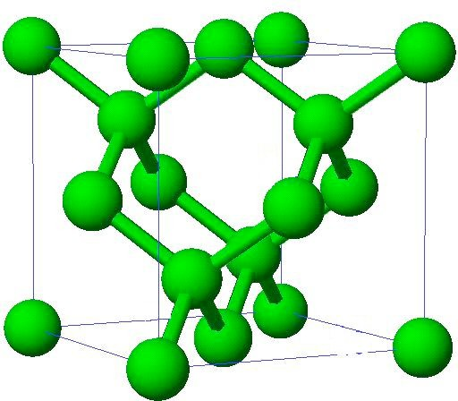
What is Materials Science and Engineering?
An interdisciplinary field that addresses the fundamental relationship between the Processing, Structure and Properties of materials and develops them for the desired technological applications (Performance)

Slide 3
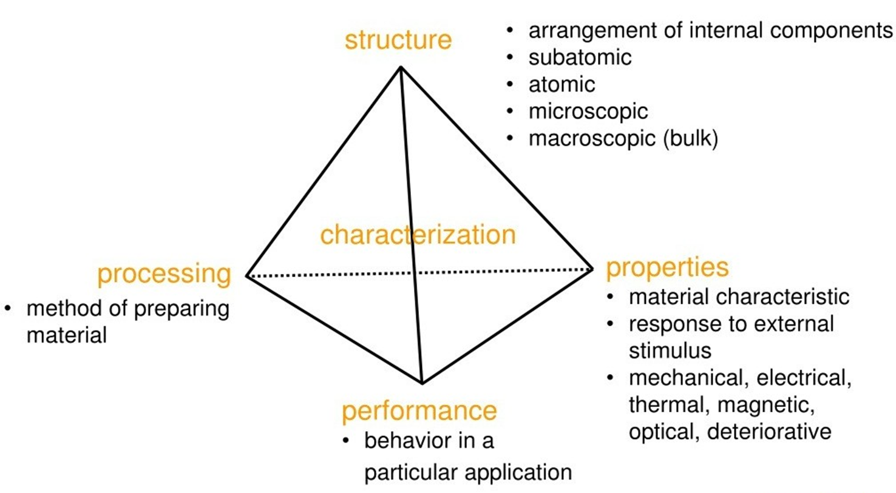
Materials Science and Engineering

Slide 4
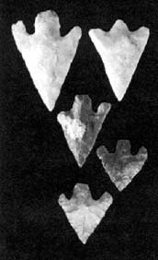
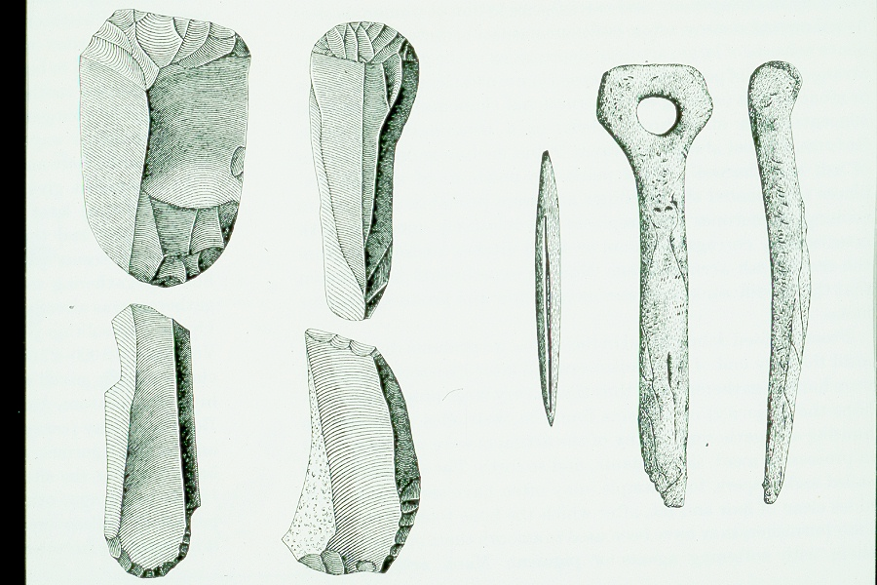
Materials through the ages
Stone Age (beginning of life – 3000 BC)
Feature: Using naturally occurring materials with only changes in shape

Slide 5



Materials through the ages
Bronze Age (3000 BC – 1200 BC)
Copper and Tin alloy
Ability to modify materials by refining (using heat), chemical modifications (alloying) and mechanical deformation (cold working)

Slide 6
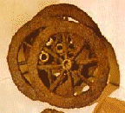


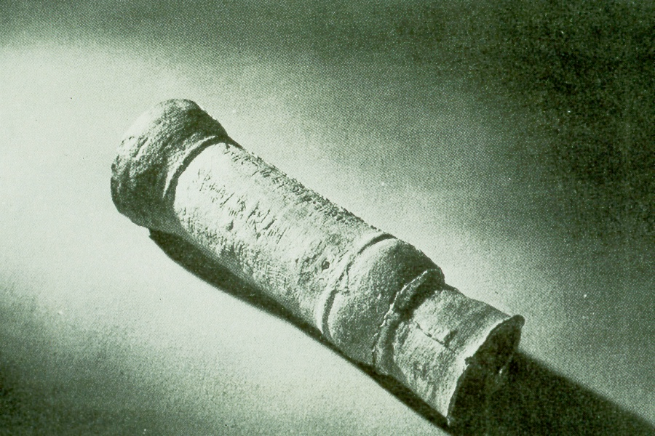
Materials through the ages
Iron Age (1200 BC – Present)
Casting and alloying wasn’t perfected until 16th century
Mastery of Steel (Iron alloy) technology enabled Industrial Revolution in the 18th and 19th century
Ability to heat treat at high temperature, control microstructure at different length scale and ability to design specific microstructures for specific properties

Slide 7


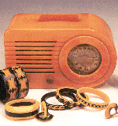

Materials through the ages
Plastic Age (1940 - Present)
Discovery of polymers, and the ability to synthesize and process polymers.

Slide 8

Materials through the ages
Silicon Age (1950 - Present)
Commercialization of silicon technology (integrated circuits, electronic devices, etc…) led to the information age, which gave a boost to human productivity
Ability to control alloying accurately, ability to make thin films
7

Slide 9
Computational Materials Science
Computational materials science (CMS) is a field that uses computers to study the properties and structures of materials, and how they relate to processing conditions. It uses physical modeling, machine learning, and theoretical models to understand the relationships between material structure and properties. CMS can be used for many purposes, including:
CMS can help researchers discover new materials and investigate existing inorganic materials, such as metals.
CMS can be used to improve the properties of materials, such as piezoelectric smart materials, which can convert mechanical energy into electrical energy.
CMS can help researchers explain experiments and explore materials theories.
Advances in computing power and software allow researchers to design, synthesize, characterize, and test materials in a virtual setting.

Slide 10
Computational Materials Applications
Properties of materials are not only determined by their respective chemical composition, but also to a large degree by their microstructure. Studying the interrelation between processing, structure and properties of materials is thus at the heart of materials science.
The often competing, complex mechanisms take place on a range of different length- and time scales, requiring the development of new simulation methods suitable for scale-bridging.
The investigation of crystal and defect properties for example, requires quantum mechanical calculations and atomistic simulation methods with typical time scales ranging from femtoseconds through nanoseconds and length scales ranging from Angströms to several hundred nanometers.
Studying the interactions, statistics and self-organization of lattice defects.
Predicting microstructure information, which are used in the design of engineering structures and devices.

Slide 11
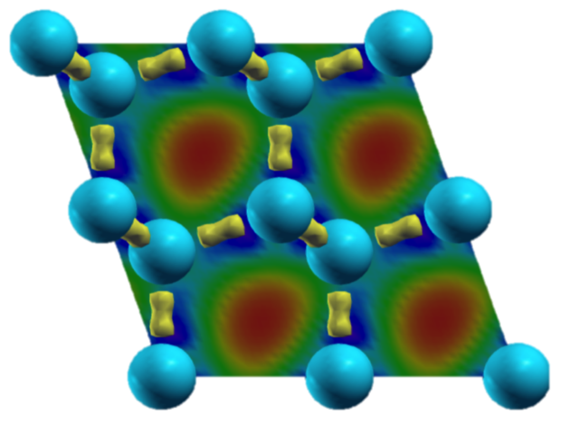
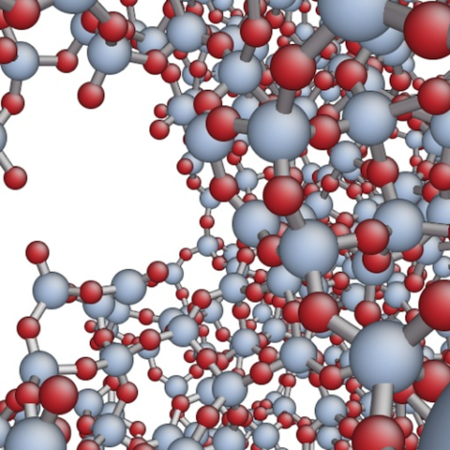
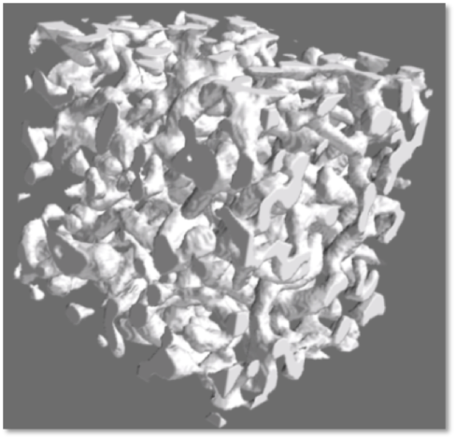
Some examples of simulation
Charge density distribution in a silicon crystal
Crack in a silicate glass
Simulation of an experimental foam structure with very high porosity

Slide 12
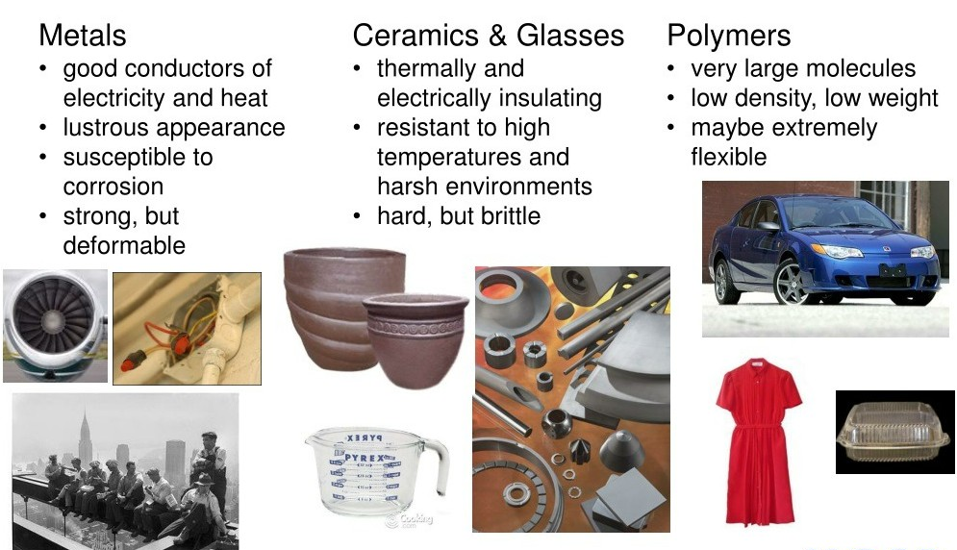
Classification of Materials

Slide 13
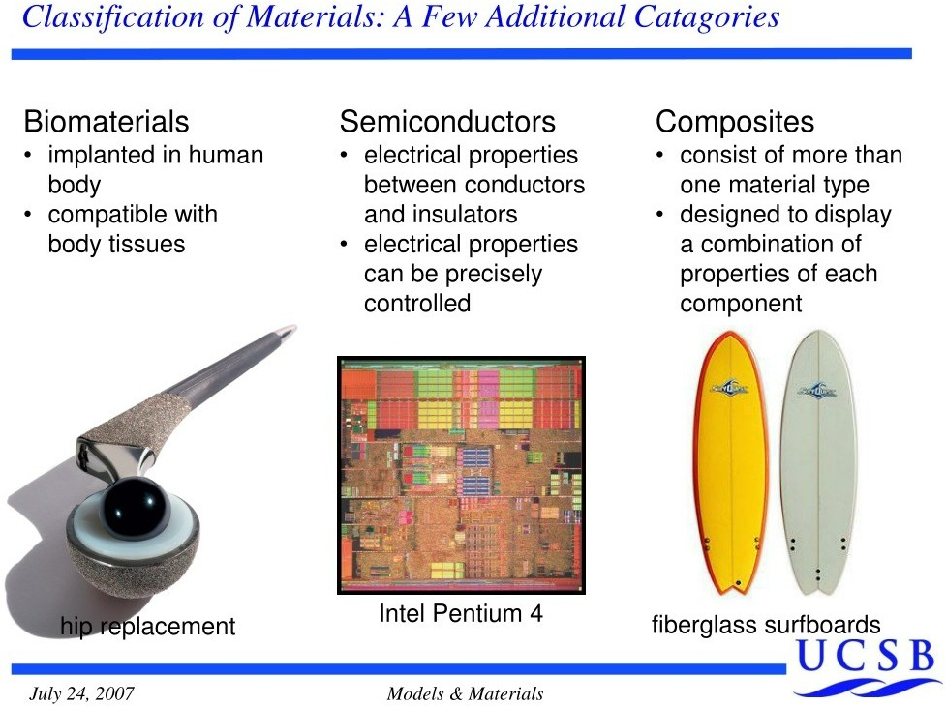
A Few Additional Categories

Slide 14
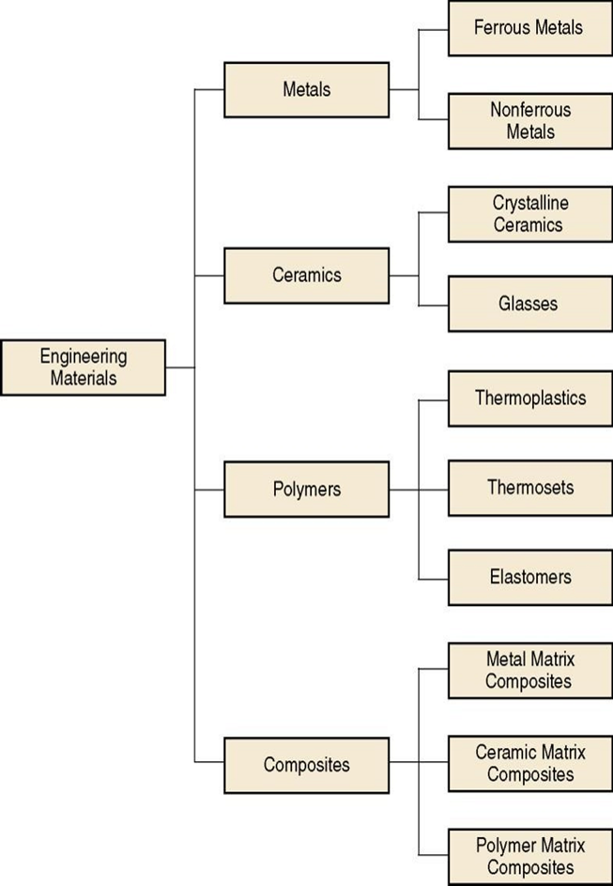
TYPES OF MATERIALS (con’t)

Slide 15
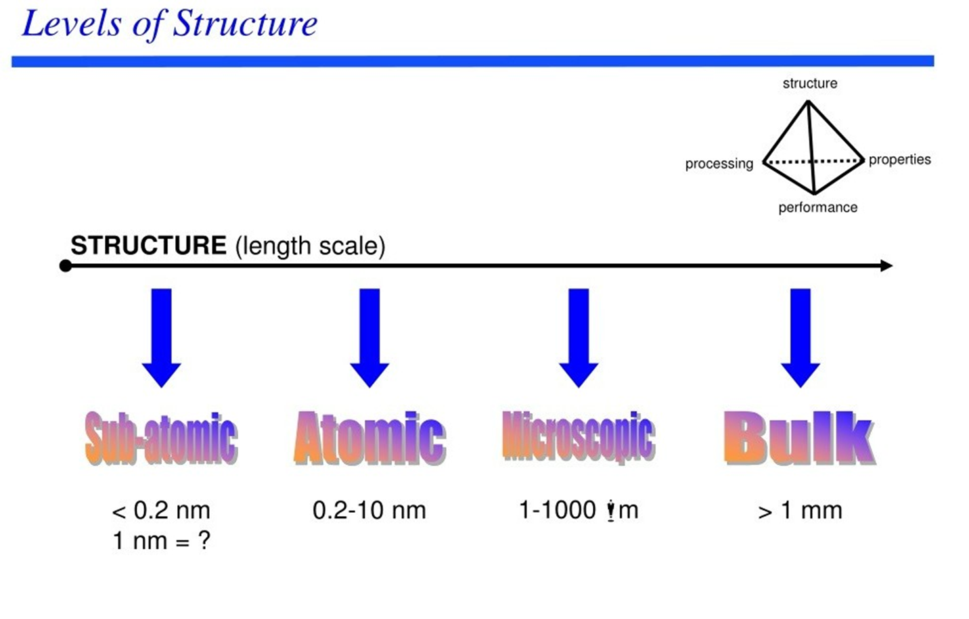

Slide 16
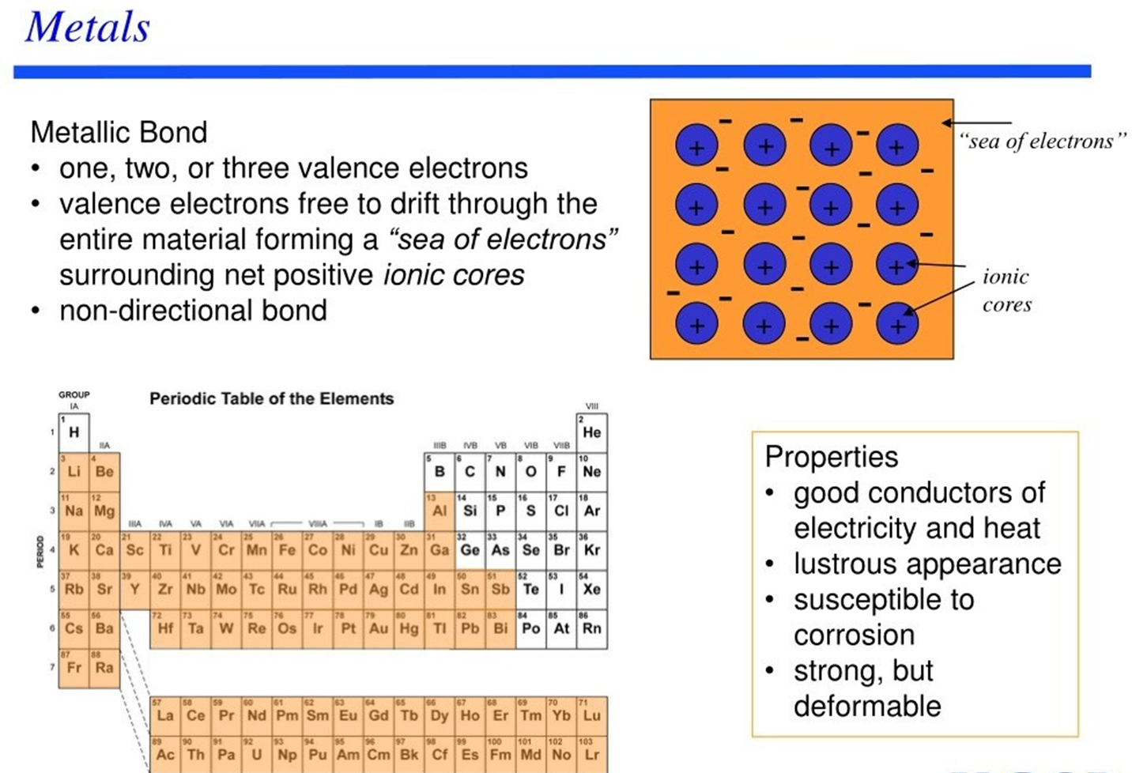

Slide 17
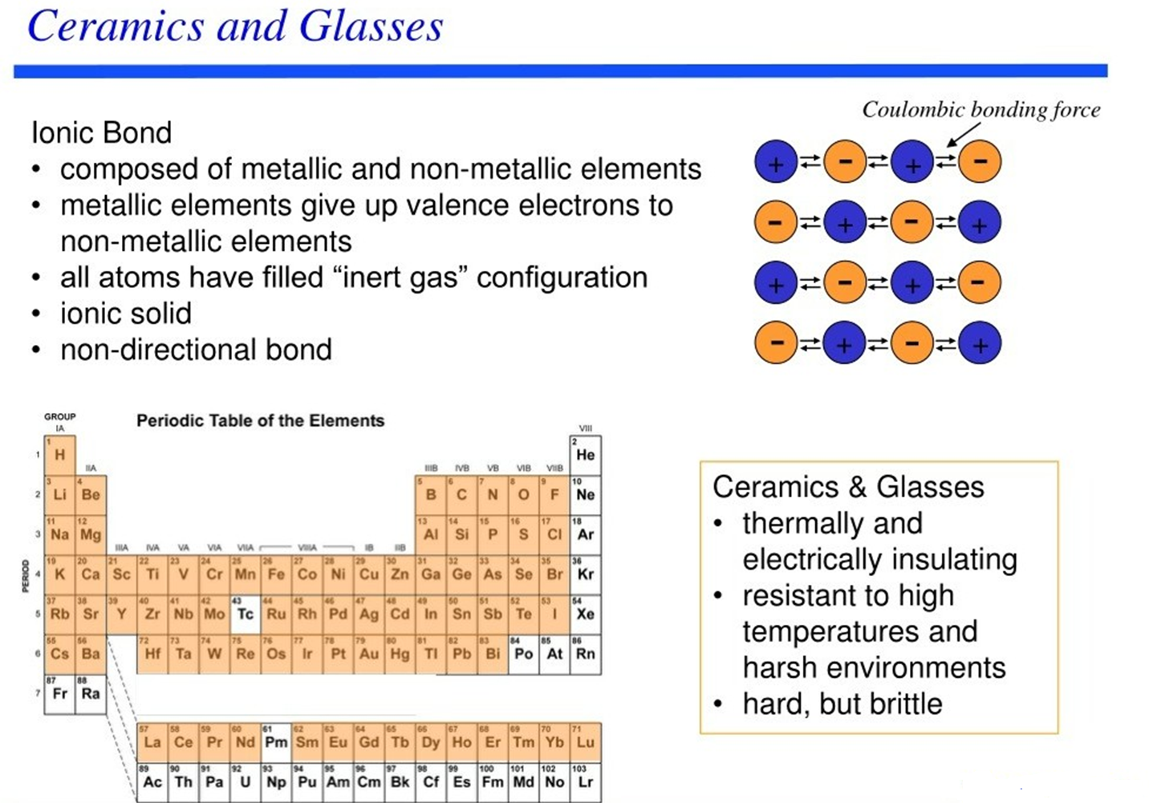

Slide 18
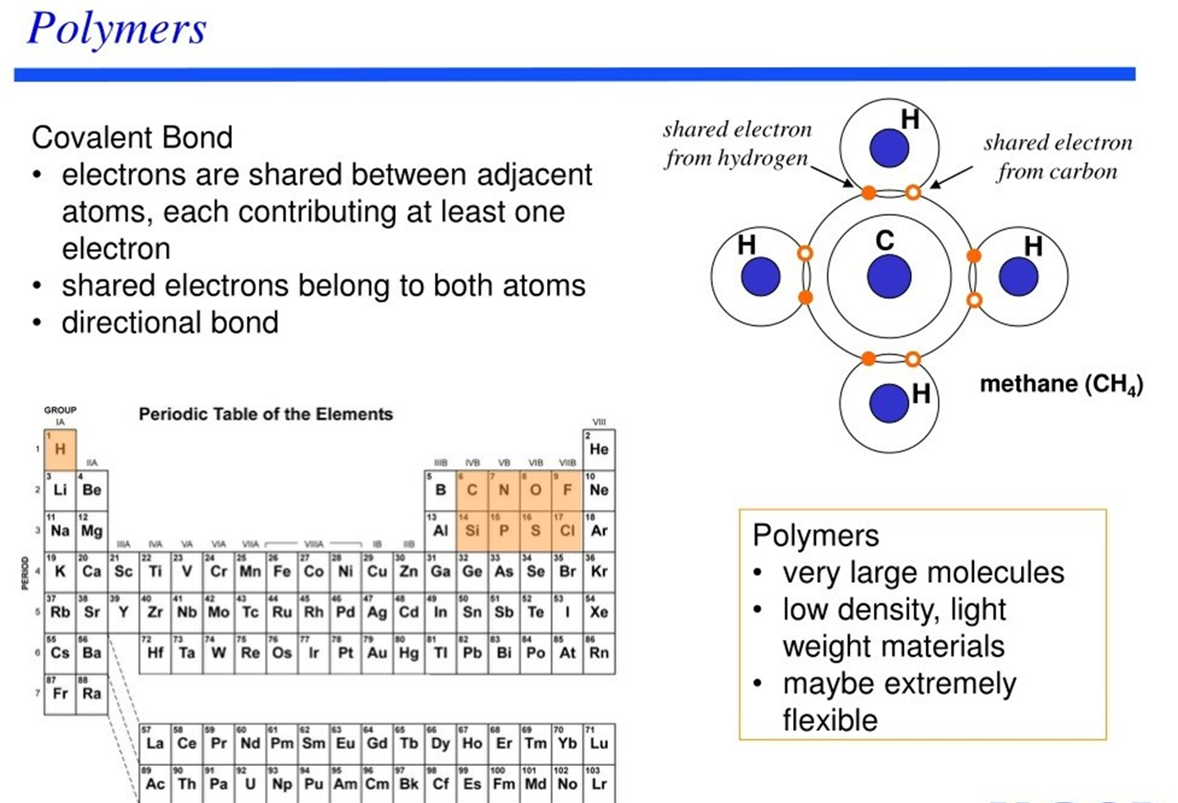

Slide 19
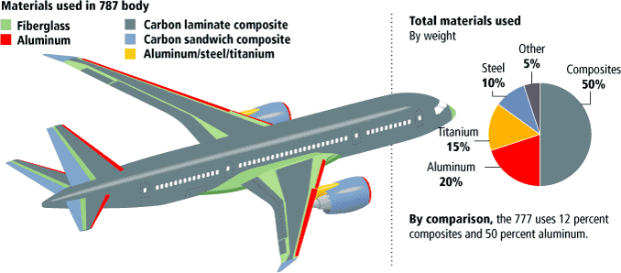
COMPOSITES
Light, strong, flexible
High costs

Slide 20
ADVANCED MATERIALS
Materials utilized in high-technology (or high-tech) applications are sometimes termed advanced materials. By high technology, we mean a device or product that operates or functions using relatively intricate and sophisticated principles, including electronic equipment (cell phones, DVD players, etc.), computers, fiber-optic systems, high-energy density batteries, energy-conversion systems, and aircraft.
Advanced materials include semiconductors, biomaterials, and what we may term materials of the future (i.e., smart materials and nanomaterials),

Slide 21
Semiconductors
Semiconductors have electrical properties that are intermediate between those of electrical conductors (i.e., metals and metal alloys) and insulators (i.e., ceramics and polymers)
Electrical characteristics of these materials are extremely sensitive to the presence of minute concentrations of impurity atoms.
Semiconductors have made possible the advent of integrated circuitry that has totally revolutionized the electronics and computer industries over the past four decades.

Slide 22
Biomaterials
A biomaterial is a substance that has been engineered to interact with biological systems for a medical purpose – either a therapeutic (treat, augment, repair, or replace a tissue function of the body) or a diagnostic one.
Replacement implants are constructed of biomaterials— materials that are implanted into the body, so that they function in a reliable, safe, and physiologically satisfactory manner, while interacting with living tissue.
Biomaterials must be biocompatible—compatible with body tissues and fluids with which they are in contact over acceptable time periods.
Biomaterial applications include joint (e.g., hip, knee) and heart valve replacements, vascular (blood vessel) grafts, fracture-fixation devices, dental restorations, and generation of new organ tissues.

Slide 23
Smart Materials
Smart (or intelligent) materials are a group of new and state-of-the-art materials now being developed that will have a significant influence on many of our technologies.
Components of a smart material (or system) include some type of sensor (which detects an input signal) and an actuator (which performs a responsive and adaptive function).
Actuators may be called upon to change shape, position, natural frequency, or mechanical characteristics in response to changes in temperature, electric fields, and/or magnetic fields.
Four types of materials are commonly used for actuators: shape-memory alloys, piezoelectric ceramics, magnetostrictive materials, and electrorheological /magnetorheological fluids.
Shape-memory alloys are metals that, after having been deformed, revert to their original shape when temperature is changed.
Piezoelectric ceramics expand and contract in response to an applied electric field (or voltage); conversely, they also generate an electric field when their dimensions are altered
The behavior of magnetostrictive materials is analogous to that of piezoelectrics, except that they are responsive to magnetic fields.
Electrorheological and magnetorheological fluids are liquids that experience dramatic changes in viscosity upon the application of electric and magnetic fields, respectively.

Slide 24
Nanomaterials
Nanomaterials are materials with at least one dimension measuring 100 nanometers or less, and can be found in the form of particles, tubes, rods, or fibers.
Nanomaterials can be natural or human-made, and can be made from any element. They are often categorized as organic (carbon based), inorganic (non-carbon based), or hybrid (a combination of the two).
Nanomaterials have unique properties that make them attractive to researchers, including: High surface area for chemical reactions, Unique surface structures, Different ways of interacting with light, and Size-tunable electronic properties.

Slide 25
Nanomaterials Applications
Healthcare: Nanomaterials can help with medical diagnosis, drug delivery, and imaging.
Electronics: Nanomaterials are useful in electronics due to their small size.
Cosmetics: Thousands of everyday products, including cosmetics, are made with engineered nanomaterials.
Textiles: Nanomaterials can be added to materials like cloth to make them lighter but stronger.
Environmental protection: Nanomaterials can bind with and help neutralize toxins.

